Slide 1





HackOrbit 2025
ARC

Slide 2

THEME & PROBLEM STATEMENT
The Problem: Missing Out on Fast-Paced Auctions
Accessibility Challenges for Non-Tech Users
Lack of Real-Time Voice
Experience
Missed Bids in Fast-Paced Auctions
Traditional online auctions are incredibly fast, leading to many users missing out on crucial bidding opportunities due to slow reaction times or technical difficulties.
Complex online platforms can be daunting for users who are not tech-savvy, creating a barrier to entry for a significant portion of potential bidders.
There's a significant gap in the market for a truly real-time, voice-based auction experience, limiting convenience and immediate interaction.
Theme: Artificial Intelligence and Open Innovation

Slide 3
PROPOSED SOLUTION
Our voice agent leverages OmniDimension, ElevenLabs, and Deepgram for advanced voice processing and natural language understanding, making interactions smooth and responsive.
A robust backend built with Flask APIs and MongoDB ensures seamless integration between the voice agent and the web interface, handling all auction logic and data.
We've implemented a secure login system and integrated a user wallet, allowing for safe fund management and bid validation against available balances.

Slide 4

METHODOLOGY AND IMPLEMENTATION

Slide 5
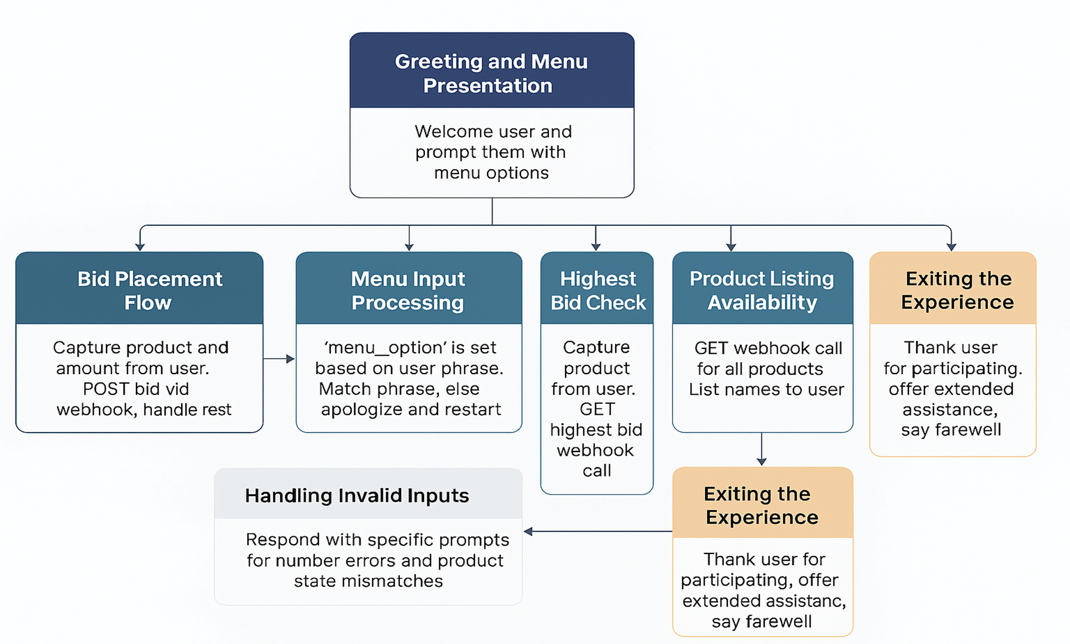
Voice Agent Flow

Slide 6

FEATURES AND NOVELTY

Slide 7


FEATURES AND NOVELTY

Slide 8
DRAWBACK AND SHOWSTOPPERS
Ensuring accurate voice recognition and intent mapping in noisy or diverse speaking environments.
Maintaining seamless multi-turn conversation flow for bid placement, especially with incomplete or ambiguous inputs.
Concurrency in Auctions: Managing multiple users bidding on the same product simultaneously, while avoiding race conditions and stale data.

Slide 9
Team Details
Team Name: ARC
Team Leader Name: Shrey omer
Email: luckyomer10@gmail.com
Team Member Name: Anuj Soni Email: soni3anuj@gmail.com
Theme: Agentic AI and Open Innovation

Slide 10
Thank you

